Slide 1
Virtual Memory
Chapter 8

Slide 2
Hardware and Control Structures
Memory references are dynamically translated into physical addresses at run time
  A process may be swapped in and out of main memory such that it occupies different regions
A process may be broken up into pieces that do not need to located contiguously in main memory
  All pieces of a process do not need to be loaded in main memory during execution

Slide 3
Execution of a Program
Operating system brings into main memory a few pieces of the program
Resident set - portion of process that is in main memory
An interrupt is generated when an address is needed that is not in main memory
Operating system places the process in a blocking state

Slide 4
Execution of a Program
Piece of process that contains the logical address is brought into main memory
  Operating system issues a disk I/O Read request
  Another process is dispatched to run while the disk I/O takes place
  An interrupt is issued when disk I/O complete which causes the operating system to place the affected process in the Ready state

Slide 5
Advantages of
Breaking up a Process
More processes may be maintained in main memory
  Only load in some of the pieces of each process
  With so many processes in main memory, it is very likely a process will be in the Ready state at any particular time
A process may be larger than all of main memory

Slide 6
Types of Memory
Real memory
  Main memory
Virtual memory
  Memory on disk
  Allows for effective multiprogramming and relieves the user of tight constraints of main memory

Slide 7
Thrashing
Swapping out a piece of a process just before that piece is needed
The processor spends most of its time swapping pieces rather than executing user instructions

Slide 8
Principle of Locality
Program and data references within a process tend to cluster
Only a few pieces of a process will be needed over a short period of time
Possible to make intelligent guesses about which pieces will be needed in the future
This suggests that virtual memory may work efficiently

Slide 9
Support Needed for
Virtual Memory
Hardware must support paging and segmentation
Operating system must be able to management the movement of pages and/or segments between secondary memory and main memory

Slide 10
Paging
Each process has its own page table
Each page table entry contains the frame number of the corresponding page in main memory
A bit is needed to indicate whether the page is in main memory or not

Slide 11
Modify Bit in
Page Table
Another modify bit is needed to indicate if the page has been altered since it was last loaded into main memory
If no change has been made, the page does not have to be written to the disk when it needs to be swapped out

Slide 12
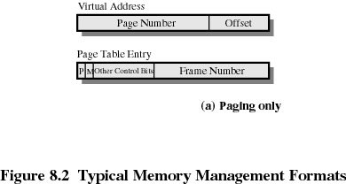
Page Table Entries

Slide 13
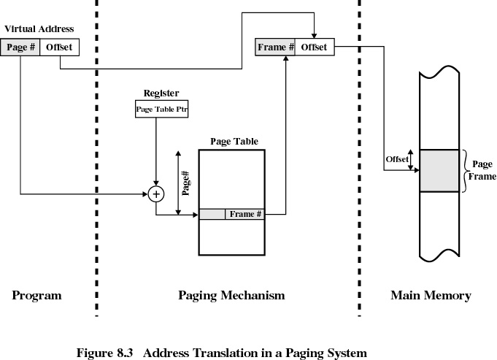

Slide 14
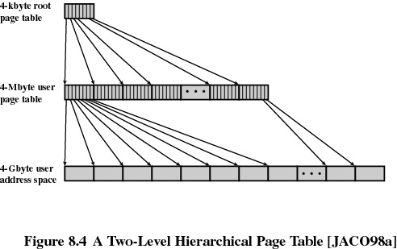
Two-Level Scheme for
32-bit Address

Slide 15
Page Tables
The entire page table may take up too much main memory
Page tables are also stored in virtual memory
When a process is running, part of its page table is in main memory

Slide 16
Translation Lookaside Buffer
Each virtual memory reference can cause two physical memory accesses
  one to fetch the page table
  one to fetch the data
To overcome this problem a high-speed cache is set up for page table entries
  called the TLB - Translation Lookaside Buffer

Slide 17
Translation Lookaside Buffer
Contains page table entries that have been most recently used
Functions same way as a memory cache

Slide 18
Translation Lookaside Buffer
Given a virtual address, processor examines the TLB
If page table entry is present (a hit), the frame number is retrieved and the real address is formed
If page table entry is not found in the TLB (a miss), the page number is used to index the process page table

Slide 19
Translation Lookaside Buffer
First checks if page is already in main memory
  if not in main memory a page fault is issued
The TLB is updated to include the new page entry

Slide 20
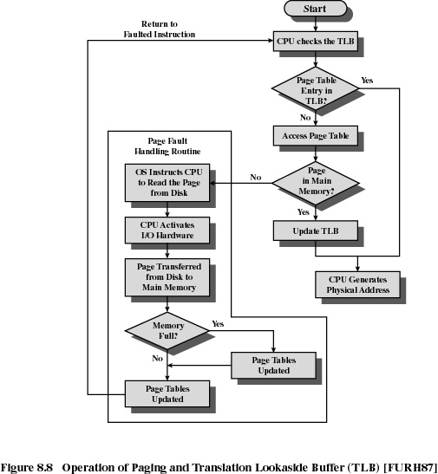

Slide 21
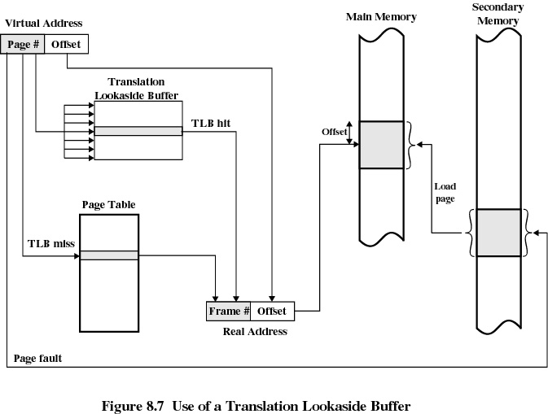

Slide 22
Page Size
Smaller page size, less amount of internal fragmentation
Smaller page size, more pages required per process
More pages per process means larger page tables
Larger page tables means large portion of page tables in virtual memory
Secondary memory is designed to efficiently transfer large blocks of data so a large page size is better

Slide 23
Page Size
Small page size, large number of pages will be found in main memory
As time goes on during execution, the pages in memory will all contain portions of the process near recent references. Page faults low.
Increased page size causes pages to contain locations further from any recent reference. Page faults rise.

Slide 24
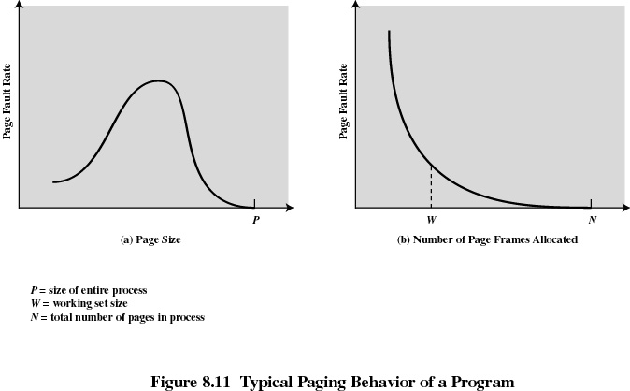

Slide 25
Page Size
Multiple page sizes provide the flexibility needed to effectively use a TLB
Large pages can be used for program instructions
Small pages can be used for threads
Most operating system support only one page size

Slide 26
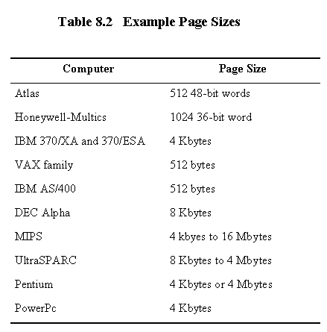
Example Page Sizes

Slide 27
Segmentation
May be unequal, dynamic size
Simplifies handling of growing data structures
Allows programs to be altered and recompiled independently
Lends itself to sharing data among processes
Lends itself to protection

Slide 28
Segment Tables
corresponding segment in main memory
Each entry contains the length of the segment
A bit is needed to determine if segment is already in main memory
Another bit is needed to determine if the segment has been modified since it was loaded in main memory

Slide 29
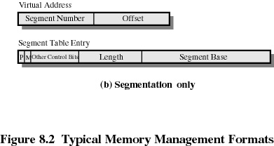
Segment Table Entries

Slide 30
Combined Paging and Segmentation
Paging is transparent to the programmer
Paging eliminates external fragmentation
Segmentation is visible to the programmer
Segmentation allows for growing data structures, modularity, and support for sharing and protection
Each segment is broken into fixed-size pages

Slide 31
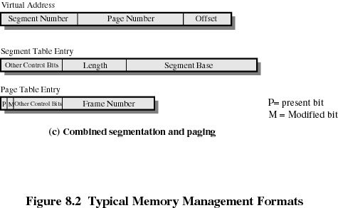
Combined Segmentation and Paging

Slide 32
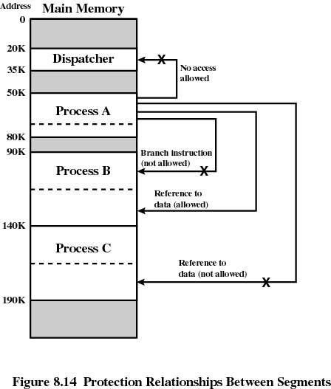

Slide 33
Fetch Policy
Fetch Policy
  Determines when a page should be brought into memory
  Demand paging only brings pages into main memory when a reference is made to a location on the page
    Many page faults when process first started
  Prepaging brings in more pages than needed
    More efficient to bring in pages that reside contiguously on the disk

Slide 34
Replacement Policy
Placement Policy
  Which page is replaced?
  Page removed should be the page least likely to be referenced in the near future
  Most policies predict the future behavior on the basis of past behavior

Slide 35
Replacement Policy
Frame Locking
  If frame is locked, it may not be replaced
  Kernel of the operating system
  Control structures
  I/O buffers
  Associate a lock bit with each frame

Slide 36
Basic Replacement Algorithms
Optimal policy
  Selects for replacement that page for which the time to the next reference is the longest
  Impossible to have perfect knowledge of future events

Slide 37
Basic Replacement Algorithms
Least Recently Used (LRU)
  Replaces the page that has not been referenced for the longest time
  By the principle of locality, this should be the page least likely to be referenced in the near future
  Each page could be tagged with the time of last reference. This would require a great deal of overhead.

Slide 38
Basic Replacement Algorithms
First-in, first-out (FIFO)
  Treats page frames allocated to a process as a circular buffer
  Pages are removed in round-robin style
  Simplest replacement policy to implement
  Page that has been in memory the longest is replaced
  These pages may be needed again very soon

Slide 39
Basic Replacement Algorithms
Clock Policy
  Additional bit called a use bit
  When a page is first loaded in memory, the use bit is set to 0
  When the page is referenced, the use bit is set to 1
  When it is time to replace a page, the first frame encountered with the use bit set to 0 is replaced.
  During the search for replacement, each use bit set to 1 is changed to 0

Slide 40
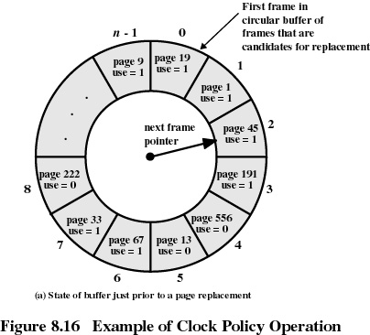

Slide 41
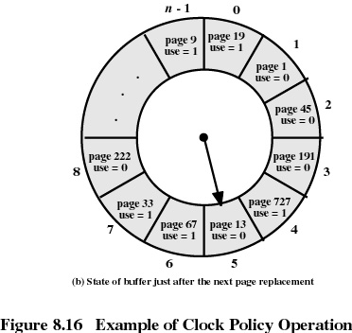

Slide 42
Basic Replacement Algorithms
Page Buffering
  Replaced page is added to one of two lists
    free page list if page has not been modified
    modified page list

Slide 43
Resident Set Size
Fixed-allocation
  gives a process a fixed number of pages within which to execute
  when a page fault occurs, one of the pages of that process must be replaced
Variable-allocation
  number of pages allocated to a process varies over the lifetime of the process

Slide 44
Variable Allocation,
Global Scope
Easiest to implement
Adopted by many operating systems
Operating system keeps list of free frames
Free frame is added to resident set of process when a page fault occurs
If no free frame, replaces one from another process

Slide 45
Variable Allocation,
Local Scope
When new process added, allocate number of page frames based on application type, program request, or other criteria
When page fault occurs, select page from among the resident set of the process that suffers the fault
Reevaluate allocation from time to time

Slide 46
Cleaning Policy
Demand cleaning
  a page is written out only when it has been selected for replacement
Precleaning
  pages are written out in batches

Slide 47
Cleaning Policy
Best approach uses page buffering
  Replaced pages are placed in two lists
    Modified and unmodified
  Pages in the modified list are periodically written out in batches
  Pages in the unmodified list are either reclaimed if referenced again or lost when its frame is assigned to another page

Slide 48
Load Control
Determines the number of processes that will be resident in main memory
Too few processes, many occasions when all processes will be blocked and much time will be spent in swapping
Too many processes will lead to thrashing

Slide 49
Process Suspension
Lowest priority process
Faulting process
  this process does not have its working set in main memory so it will be blocked anyway
Last process activated
  this process is least likely to have its working set resident

Slide 50
Process Suspension
Process with smallest resident set
  this process requires the least future effort to reload
Largest process
  obtains the most free frames
Process with the largest remaining execution window

Slide 51
UNIX and Solaris Memory Management
Paging System
  Page table
  Disk block descriptor
  Page frame data table
  Swap-use table

Slide 52
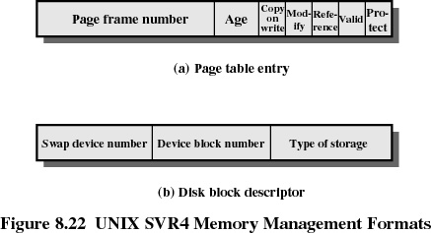
Data Structures

Slide 53
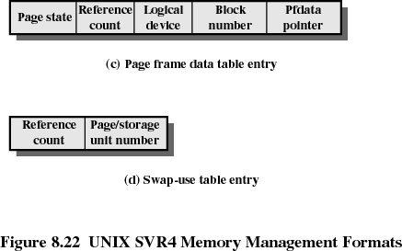
Data Structures

Slide 54
UNIX and Solaris Memory Management
Page Replacement
  refinement of the clock policy
Kernel Memory Allocator
  most blocks are smaller than a typical page size

Slide 55
Linux Memory Management
Page directory
Page middle directory
Page table

Slide 56
Windows 2000
Memory Management
W2K Paging
  Available
  Reserved
  Committed

Slide 57
